Slide 1
Moving Forward
Building and Leading a Business Relations Unit
Ryan Jolley, Business Services Unit – September 27, 2018

Slide 2
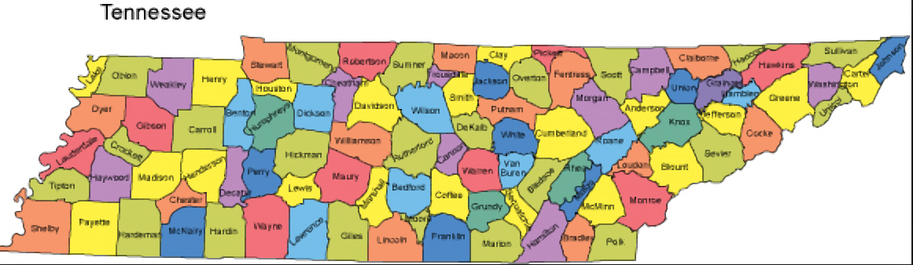
State of Tennessee Landscape
95 counties
3 Grand Divisions
9 geographic regions

Slide 3
Division of Rehabilitation Services Programs
Disability Determination Services
Vocational Rehabilitation
Comprehensive TN Rehabilitation Center
17 Community TN Rehabilitation Centers
TN Business Enterprise
TN Technology Access Program
TN Council Deaf, Deaf Blind and Hard of Hearing
Independent Living

Slide 4
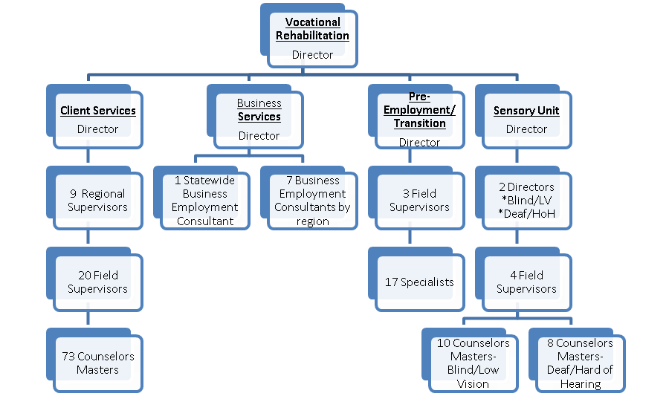
Vocational Rehabilitation Organization Chart

Slide 5
Background
Education and experience of Business Employment Consultants (BECs)
Decentralized Supervision- BECs reported to TRC managers or field supervisors
Client Centered
Autonomous in day to day operations
Lack of clarity in defining roles and expectations
Lack of centralized supervision and leadership

Slide 6
Project Purpose and Goals
Build agency capacity to work with the business community and increase competitive integrated employment outcomes.
Strengthen training opportunities for staff focusing on building and maintaining employer relations.
Enhance data collection processes to support the Business Services Unit.
Increase understanding of how to use labor market information (LMI) at the field staff level (BECs and counselors).

Slide 7
Accomplishments
Director of Business Services
Created an organized unit structure
Job descriptions developed and hiring of additional BECs. JDVRTAC provided examples and gave input as we developed ours.
Reached out to other VR agencies across the nation as referred by JDVRTAC to explore other state agency models.
Weekly cadence call with BEC team and weekly one-on-one between Director and BEC.

Slide 8
Accomplishments
Contract with University of Tennessee’s Center for Literacy, Education, and Employment (UT-CLEE) to provide onboarding to the BEC’s.
UT-CLEE provides Business Engagement Training.
Data tracking improved with assistance of JDVRTAC and introduction to the broader Community of Practice.
Drafted a survey for field staff. JDVRTAC provided input and assistance for this draft.
JDVRTAC assisted to identify resources for Labor Market Information tools and training.

Slide 9
Challenges and Lessons
Change in Department and Division Leadership
Previous Director resigned in June 2018
Change in Business Service Unit leadership
Change in project liaison/leadership
Communication between Field Counselors and Business Employment Consultants

Slide 10
JDVRTAC Assistance
Connected to other states for models of data collection, LMI usage, and Business Engagement models
Provided resource material in the form of job descriptions and data collection tools.
Provided overall direction and guidance
JDVRTAC participated in monthly calls with leadership and teams when possible
Site visits to Nashville included time spent with team and leadership for training and brainstorming

Slide 11
Next Steps
Conduct analysis of client supply to meet labor force demands of employers
Conduct analysis of employer supplies to meet clients’ vocational outcome demand
Increase qualitative business engagement and services
Organization and Structure of Business Unit
Clarify roles/expectations of BECS and Counselors
Create and implement operational standards

Slide 12

Questions

